Slide 1


K.L.N. COLLEGE OF ENGINEERING
(An Autonomous Institution, Affiliated to Anna university, Chennai)
DEPARTMENT OF COMPUTER SCIENCE AND ENGINEERING
InternHub – AI Powered Personalized Internship Recommendation System
DOMAIN NAME :
ARTIFICIAL INTELLIGENCE & MACHINE LEARNING & FULL STACK
GUIDE :
Mrs.S.YOHESWARI
Associate Professor 2
Department of Computer Science and Engineering
TEAM MEMBERS :
AAKSATH NITHIL SAAM SS [910623104001]
JAYABALAJIVEL R [910623104036]
1

Slide 2
ABSTRACT
  InternHub is an AI-powered web application designed to help students find personalized internship opportunities based on their skills, educational background, and career interests
  The system analyzes the uploaded resume using Natural Language Processing (NLP) to automatically extract important information such as technical skills, domain, education, and project experience.
  Based on the extracted information, InternHub fetches real-time internship opportunities from trusted job APIs and recommends internships that best match the student's profile
  The system improves reliability by filtering duplicate or suspicious internship postings, provides AI-based resume improvement suggestions, and allows students to save and track their internship applications.
2

Slide 3
INTRODUCTION
  Internships are an essential part of a student's career because they provide practical knowledge, industry exposure, and real-world experience before graduation.
  Most existing internship platforms display generic internship listings without considering a student's skills, interests, or career goals, making it difficult to find suitable opportunities.
  InternHub is an AI-powered personalized internship recommendation system that analyzes a student's resume to identify technical skills, educational qualifications, preferred domain, and strengths.
  Using Artificial Intelligence, Natural Language Processing (NLP), and real-time internship APIs, the system recommends relevant internship opportunities while filtering duplicate and suspicious postings.
3

Slide 4
LITERATURE SURVEY
S. No | Paper Title | Year of publication, Vol No., Issue No., PP | Journal Name / Authors | Methodology | Merits/Demerits
1. | AI-Based Internship Recommendation System | 18 March 2024,Vol.no:12. | IEEE Explore / P Madhavi Reddy ,Geethanjali BS ,Shivang Karol ,Vaishakh Pavan Ganesh R ,R Jennie Bharathi | The student registers on the system and enters academic details, skills, and preferences. The system preprocesses the collected data and extracts important features such as skills, education, and domain. AI-based recommendation algorithms compare the student's profile with available internship requirements using content-based filtering and semantic analysis. | Merits : The system provides personalized internship recommendations based on student skills and interests. It reduces the time required to search for suitable internships and improves recommendation accuracy using AI techniques. It also enhances the user experience by providing relevant and efficient internship suggestions. Demerits The system's performance depends on the quality of user data and internship information. New users may receive less accurate recommendations.
4

Slide 5
LITERATURE SURVEY
S. No | Paper Title | Authors & Publications | Methodology | Merits/Demerits
2. | TechTrack: An Internship Matching Platform for Career Recommendation Using Machine Learning | 2026 11th International Conference on Business and Industrial Research (ICBIR) | 979-8-3315-4741-7/26/$31.00 ©2026 IEEE | DOI: 10.1109/ICBIR69932.2026.11584730 | Students often struggle to choose the right career path when entering college, particularly in computing and technology programs where early specialization significantly impacts future employability. Traditional academic advising is often generalized and lacks the personalized, datadriven guidance required to navigate modern tech industry demands | Merits : The system provides accurate and personalized internship recommendations based on students' skills and interests. It saves time, improves career guidance, and enhances the overall internship search experience. Demerits : The system depends on accurate student data and updated internship information for effective recommendations. It also requires internet connectivity and regular maintenance to ensure reliable performance.
5

Slide 6
LITERATURE SURVEY
S. No | Paper Title | Year of publication, Vol No., Issue No., PP | Journal Name / Authors | Methodology | Merits/Demerits
3. | AI-Driven Internship Matching Using SkillBased Recommendation System | Proceedings of the National Conference on Emerging Computer Applications (NCECA)-2026 Vol. 7, Issue.1 | Soorya Mol S PG Scholar ,Merin Manoj Assistant Professor ,Amal Jyothi College of Engineering (Autonomous) | From academic to the industry is probably one of the biggest steps in one’s career. In order to get there, a common approach that students have, is doing internships. The internships are then a stepping stone for the practical knowledge, the professional networking and for converting the internship into full time job . | Merits : The system provides accurate and personalized internship recommendations based on students' skills and profiles. It improves matching efficiency and helps students find suitable internship opportunities quickly. Demerits : The system requires accurate user data and regular updates for effective recommendations. It may also face bias and fairness issues if the training data is incomplete or imbalanced.
6

Slide 7
LITERATURE SURVEY
S. No | Paper Title | Authors & Publications | Methodology | Merits/Demerits
4. | AI-Based Internship Recommendation Engine for the PM Internship Scheme | D. Rosy Salomi Victoria ,Gokulraj L ,Hem Kumar R ,S. Roselin Mary ,Nithya Roseline S OI: 10.1109/ICESIC67389.2026.11496549 | The methodology involves gathering and preprocessing the Walmart sales dataset, followed by training a CatBoost model. The performance of this CatBoost model is then compared with traditional methods like Linear Regression and SVM, focusing on its prediction accuracy and generalizability across different datasets. | Merits : Superior Accuracy: CatBoost delivers more precise sales predictions than traditional methods, enhancing the reliability of sales forecasts. Demerits : Resource Intensive:Training CatBoost on large datasets demands significant computational power and time, which might not be practical for all users.
7

Slide 8
EXISTING SYSTEM
  Existing internship portals mainly display internship opportunities as simple lists without providing personalized recommendations based on students' skills and interests.
  Most systems rely on keyword-based matching, which often fails to understand the actual meaning of skills and job requirements, leading to inaccurate recommendations.
  Students must manually search and filter internship postings, making the process time-consuming and causing information overload.
  Traditional recommendation systems face challenges such as cold-start problems, data sparsity, and limited adaptation to changing user preferences.
  Most existing platforms lack AI-driven semantic analysis, adaptive feedback mechanisms, and intelligent filtering, resulting in less accurate internship matching.
8

Slide 9
PROPOSED SYSTEM
  The proposed system, InternHub, is an AI-powered web application that provides personalized internship recommendations by analyzing a student's resume and technical skills.
  The system uses Natural Language Processing (NLP) to extract skills, domain, education, and strengths from the uploaded resume automatically.
  It fetches real-time internship opportunities from trusted job APIs, filters duplicate and fake listings, and recommends the most relevant internships.
  The platform enables students to save internships, apply through official links, track application status, and receive AI-based resume improvement suggestions.
  By integrating Artificial Intelligence, Machine Learning, NLP, and real-time data, the system offers an intelligent, secure, and user-friendly solution for internship discovery and career guidance.
9

Slide 10
DATAFLOW DIAGRAM
Start
User Login / Register
User Dashboard
Upload Resume / Search Internship
Resume Analysis(AI Service)
Extract skill,domain,education and calculate profile score
MongoDB Atlas Database
--------------------------------
  Users
  Profiles(Skill,Domain,Education)
  Internship(Raw+
Processed)
  Application(kanban Data
  Saved Jobs/History
Fetch Internship APIs
Get real time internships from external source(Adzuna,jooble,etc...)
Is Profile Valid?
Return Error to User
Scam Detection(AI Service)
NLP model checks job description and predicts scam probability
Cosine Similarity Matching
Match user skills with job requirements and calculate match percentage
Trust Score Engine
Calculate trust score using rules (domain, email, payment, length, etc.)
Recommended Internships
Rank and display best matched, trusted internships
Application Tracker
User applies/saves and tracks application status (Kanban)
End
10

Slide 11
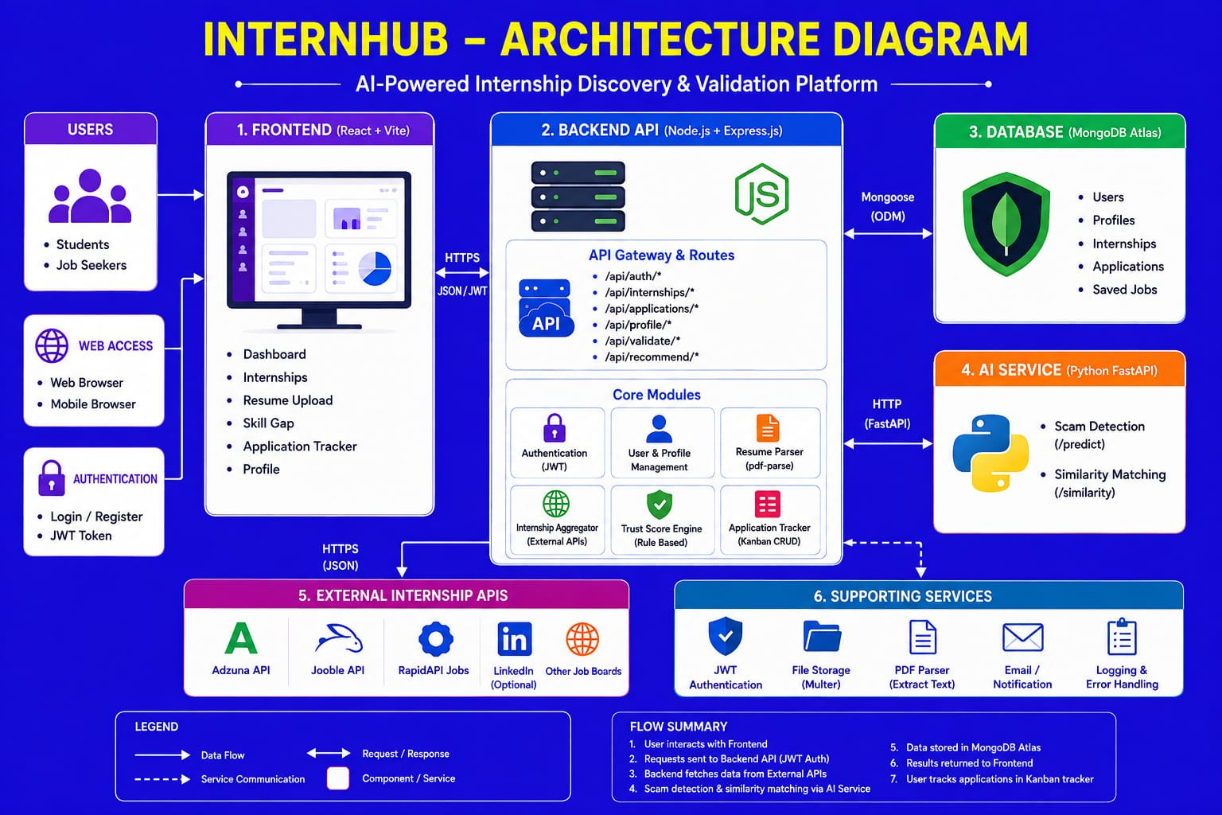
ARCHITECTURE DIAGRAM
11

Slide 12
THANK YOU
12

